Slide 1
Marine Mammal Sound Classification Using a CNN
CS4795 Project
Chris Higgins

Slide 2
Rationale:
Builds off my technical report - which overviews CNNs for animal sound classification
Main challenge of CNN acoustic classification applications is the lack of data
How hard would it be to implement an effective model with a limited dataset?

Slide 3
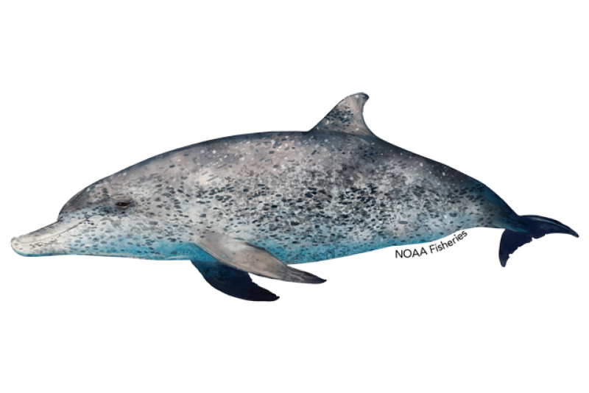
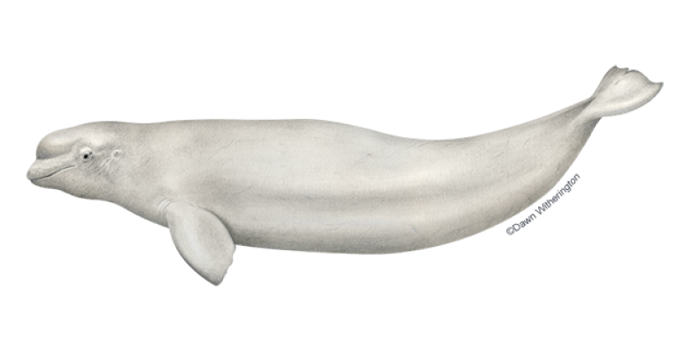
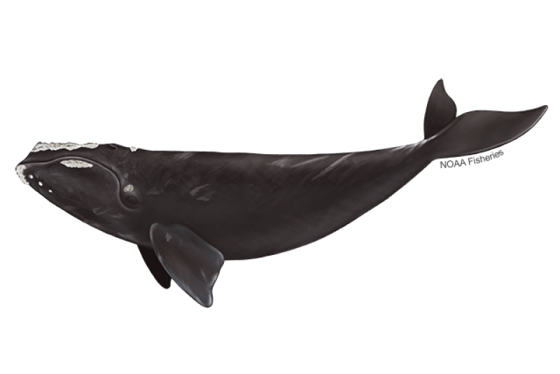
Description:
I have attempted to make a CNN model that could classify the sounds of 3 marine mammals with reasonable accuracy, while working with a limited dataset:
Atlantic Spotted Dolphin -------------------------
Beluga Whale -------------------------------
North Atlantic Right Whale -----------

Slide 4
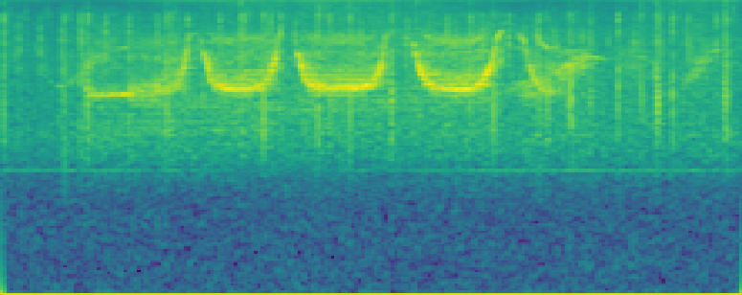
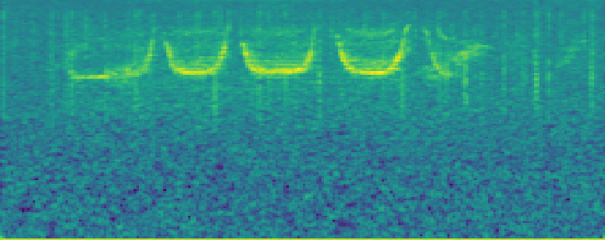
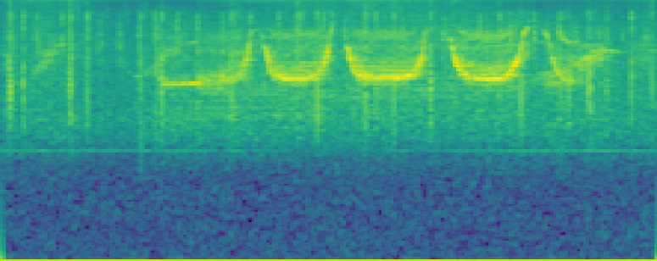
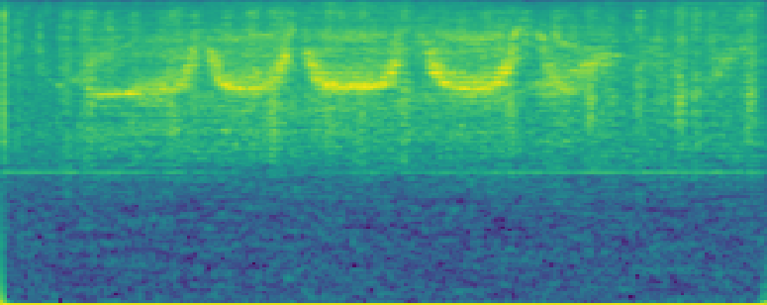
Most Interesting Idea I’ve Found:
In effort to combat my limited data I used data augmentation:
Apply different techniques to my original dataset to artificially increase its volume and help to avoid overfitting:
Original
Adding additional noise
Time shifts
Pitch Shifts
This increased my dataset by 4x

Slide 5
The Difference Between My Implementation and the Idea
I relied entirely on data augmentation
Data augmentation is a great way to improve performance in the event of a limited dataset, but it is not a concrete solution
Marine mammals can each produce a variety of sounds, and in a real-world application they could be recorded using a variety of tools.
Data augmentation - while it does improve generalization - can not make up for a lack of these real-world variations

Slide 6
General Process:
Data Preprocessing
Normalize audio, apply data augmentation, and generate spectrograms
Model Training & Validation
MobileNetV2 pre-trained on ImageNet, fine-tuned to classify marine mammal vocalizations
Augmented Dataset (652 Spectrograms):
Training Set: 456
Validation Set: 98
Model Testing
Augmented Dataset:
Testing Set: 98

Slide 7
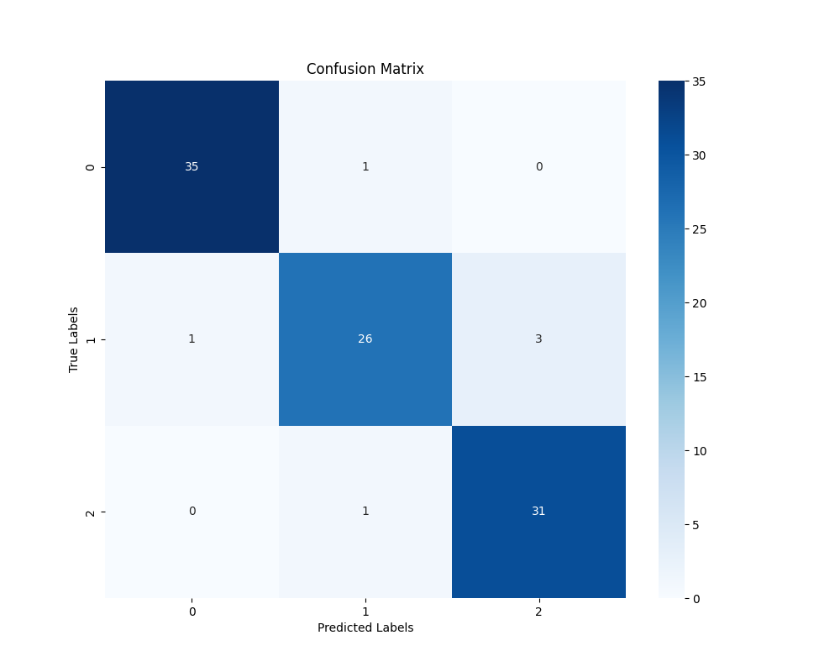
Results:
0 - Dolphin
1 - Beluga
2 - NARW
Successes:
Performed exceptionally well within the bounds
of the dataset
Avg. precision of ~ 94%
Avg. recall of ~ 94%
Could accurately classify unseen data from
the dataset
Failures:
Unsurprisingly, the performance dropped significantly when testing on data from outside of the dataset
Audio clips from YouTube or other PAM databases
Both contained audio likely recorded at different qualities, which different equipment, and contained vocalizations not captured by my training dataset

Slide 8
Takeaways:
Takeaways:
Data augmentation is a great technique for improving sample size and variability in data, but it alone cannot make up for the lack of a comprehensive dataset.
Collecting data is the most difficult and time-consuming aspect to applying CNNs to acoustic classification of animal sounds
Tweaking and fine-tuning a model can be difficult, as it is hard to know what features the model thinks are important

Slide 9
Potential Improvements:
Putting together a large and comprehensive dataset
Taking the time to collect and process data from a variety of sources to capture the real-world variance in animal sounds
Narrowing scope:
Switching to binary classification
(Animal or Not-Animal)
While this depends on purpose, building a more focused model around one species could help with generalization.

Slide 10
Conclusion
My findings mirrored the findings of my technical report:
CNNs are very capable of classifying acoustic data
There are two major challenges:
Data scarcity and imbalance
Poor model interpretability
This was a valuable learning experiences and gave me additional insight into using CNNs for classifying animal sounds.

Slide 11
GitHub:
https://github.com/chrisHigg/animal-call

